Slide 1
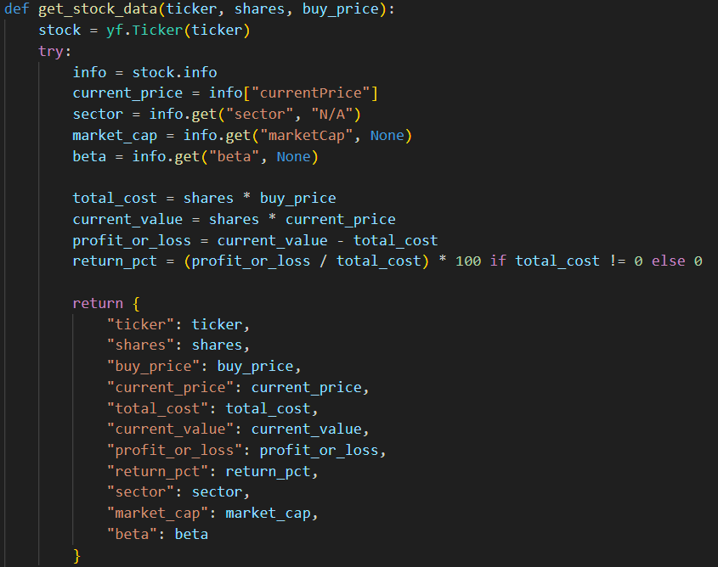
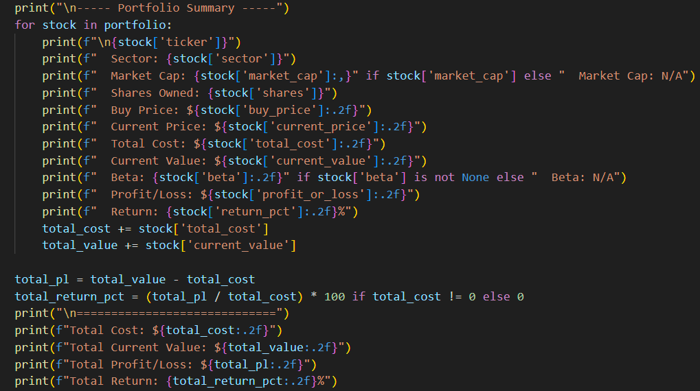
Stock Portfolio Returns Calculator
By: Christian Dal Cerro
An automated software that gives you information about the values of your stock portfolio, which can be used to help people manage their finances in a market they may not be very knowledgeable in.

